Slide 1

K Sagaa Ventures LLP
Cybersecurity, Agentic AI & Software Engineering Consultancy
Offerings overview

Slide 2
Who we are
Founded on 20+ years of experience building and scaling enterprise SaaS products in cybersecurity, analytics and AI. We bring hands-on leadership from large engineering organizations to teams that need it now.
20+
3
$50M+
100M+
years in enterprise software
US patents in forecasting & data exploration
annual revenue product line led at Qualys
patches deployed per year at Qualys
02
K Sagaa Ventures LLP

Slide 3

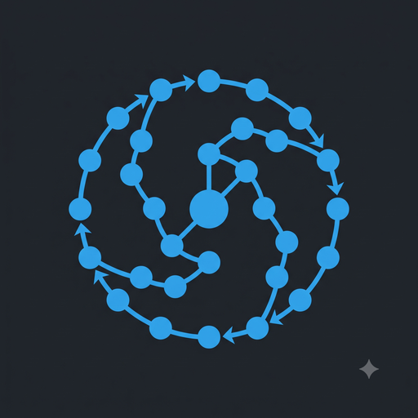
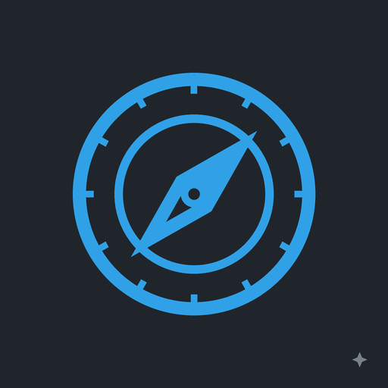
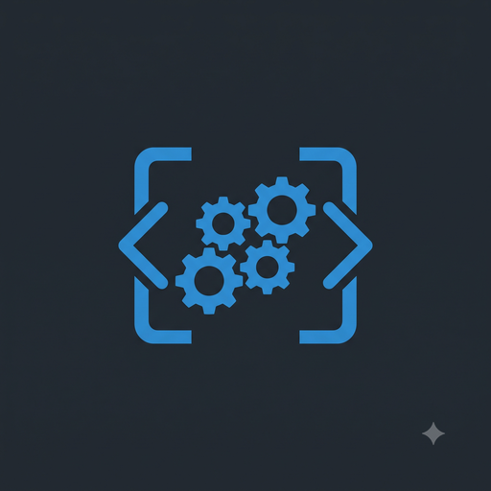

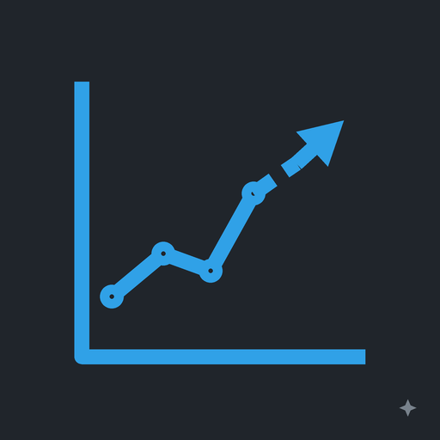
What we do
Six practice areas, one team.
Cybersecurity
Agentic AI
Consulting
Vulnerability, identity and agentic AI security for enterprise and SaaS teams.
Design and deployment of autonomous AI agent systems for business workflows and automation.
Senior technology leadership on demand, from strategy to delivery.
Software Engineering
AI/ML Training
03
Data Science & Forecasting
Full-stack architecture, system design, and implementation for enterprise-grade applications.
Hands-on training programs for engineering teams on LLM integration, agent frameworks, and MCP.
Time series forecasting and machine learning products, grounded in patented R&D.
K Sagaa Ventures LLP

Slide 4
Vulnerability & patch management advisory: program design, remediation prioritization, zero-downtime patch operations at scale
Identity visibility & access risk assessment: identity sprawl, over-privileged access, graph-based risk scoring
Agentic AI security: threat modeling, prompt-injection defence, and tool and data access controls for LLM agents
Cybersecurity
Vulnerability, identity and agentic AI security for enterprise and SaaS teams.
04
K Sagaa Ventures LLP

Slide 5
Agent system design and LangGraph / LangChain builds
RAG and LLM integration into existing products
Fine-tuning: LoRA, QLoRA and full fine-tuning
Evaluation, guardrails and production agent operations
Agentic AI
Design and deployment of autonomous AI agent systems for business workflows and automation.
05
K Sagaa Ventures LLP

Slide 6
Fractional CTO and engineering leadership for security and SaaS startups
Architecture reviews, monolith to microservices, secure multi-tenant SaaS on AWS and Kubernetes
Roadmaps, team scaling and technical due diligence
Consulting
Senior technology leadership on demand, from strategy to delivery.
06
K Sagaa Ventures LLP

Slide 7
Software Engineering & Training
Software Engineering
AI/ML Training
Cloud-native services on AWS with Kubernetes, Docker and Helm
Event-driven systems with Kafka and Elasticsearch
Python and Java delivery with CI/CD and observability built in
LLM integration and RAG workshops for product teams
Building agents with LangGraph, from prototype to production
MCP servers and tool integration: connecting agents safely to your systems and data
07
K Sagaa Ventures LLP

Slide 8
IVIP
Unified identity graph across cloud, SaaS and on-prem directories
Real-time risk scoring for over-privileged and dormant access
Agentic workflows that detect, explain and remediate identity risk
Identity Visibility and Risk Profile
IN DEVELOPMENT
Graph-based identity risk scoring with agentic AI for autonomous threat detection and adaptive access governance. See every identity, its access, and its risk in one profile.
08
K Sagaa Ventures LLP

Slide 9
How we engage
1
2
3
Assess
Build
Advise
Security, architecture or AI-readiness review
Findings and a prioritized plan in 2 to 4 weeks
Fixed-scope delivery of agents, services or security tooling
Your stack, your repo, production-ready
Fractional CTO or retainer
Roadmaps, hiring, due diligence and executive escalations
09
K Sagaa Ventures LLP

Slide 10
Why K Sagaa
Enterprise scale
Research depth
Experience running products that serve thousands of global customers and deploy 100M+ patches a year
Patented machine learning and forecasting work, presented at international conferences
Security and AI together
Hands-on leadership
One team that knows identity, patching, and how to build and secure LLM agents
The founder is in the code, the architecture and the room, not just the proposal
10
K Sagaa Ventures LLP

Slide 11
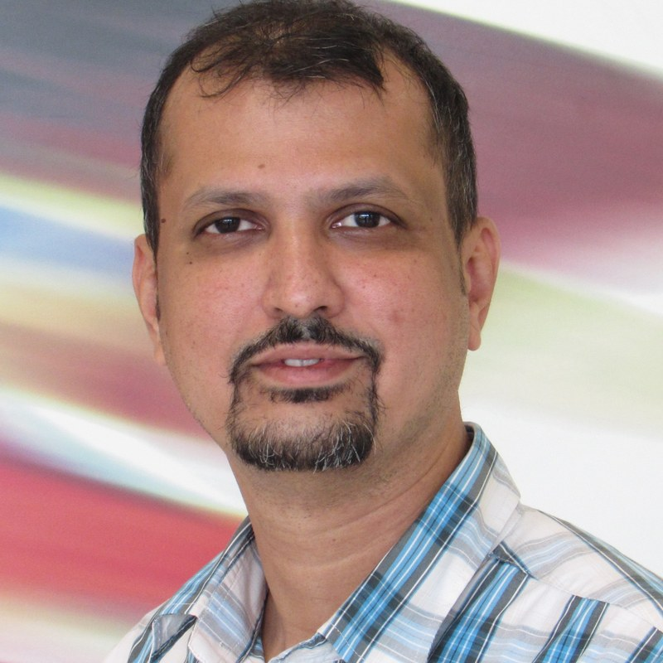
Technology executive with 20+ years building and scaling enterprise SaaS in AI, analytics and cybersecurity.
2025 – Present
Founder & Principal Consultant, K Sagaa Ventures LLP
Cybersecurity, agentic AI and software engineering consultancy. Building IVIP.
2022 – 2025
Director of Engineering, Qualys
Led the Remediation product suite (Patch Management & Mitigation) and a 50+ person org; $50M+ annual revenue; 100M+ patches/year.
2009 – 2022
Sr. Manager, Engineering, SAS Research & Development
Managed a 25-member team building ML and time series forecasting products; 3 US patents; monolith to microservices transformation.
Sagar Mainkar
Founder & Principal Consultant
linkedin.com/in/sagarm21
11
M.Sc. Business Analytics, BITS Pilani | B.E. Mechanical Engineering, Pune University

Slide 12
Let's talk
Sagar Mainkar
Founder & Principal Consultant, K Sagaa Ventures LLP
sagar@ksagaa.com
linkedin.com/in/sagarm21
Pune, Maharashtra, India

